Slide 1

DATA WAREHOUSING

Slide 2

Overview
0. Introduction
I. Data Warehousing
II. Decision Support and OLAP
III. Data Mining
IV. Looking Ahead

Slide 3

A producer wants to know….
Which are our
lowest/highest margin
customers ?
Who are my customers
and what products
are they buying?
What is the most
effective distribution
channel?
What product prom-
-otions have the biggest
impact on revenue?
Which customers
are most likely to go
to the competition ?
What impact will
new products/services
have on revenue
and margins?

Slide 4
Data, Data everywhere yet ...
I can’t find the data I need
  data is scattered over the network
  many versions, subtle differences
I can’t get the data I need
  need an expert to get the data
I can’t understand the data I found
  available data poorly documented
I can’t use the data I found
  results are unexpected
  data needs to be transformed from one form to other

Slide 5

What is a Data Warehouse?
A single, complete and consistent store of data obtained from a variety of different sources made available to end users in a what they can understand and use in a business context.
[Barry Devlin]

Slide 6
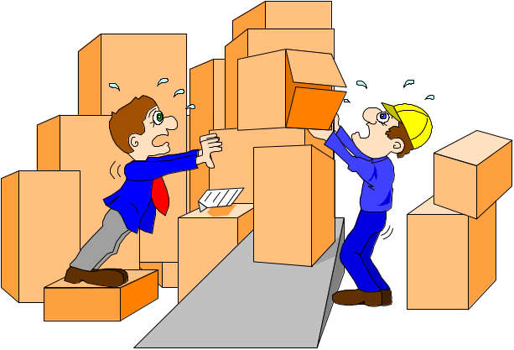
What are the users saying...
Data should be integrated across the enterprise
Summary data has a real value to the organization
Historical data holds the key to understanding data over time
What-if capabilities are required

Slide 7

What is Data Warehousing?
A process of transforming data into information and making it available to users in a timely enough manner to make a difference
[Forrester Research, April 1996]
Information
Data

Slide 8
Evolution
60’s: Batch reports
  hard to find and analyze information
  inflexible and expensive, reprogram every new request
70’s: Terminal-based DSS and EIS (executive information systems)
  still inflexible, not integrated with desktop tools
80’s: Desktop data access and analysis tools
  query tools, spreadsheets, GUIs
  easier to use, but only access operational databases
90’s: Data warehousing with integrated OLAP engines and tools

Slide 9
Warehouses are Very Large Databases
35%
30%
25%
20%
15%
10%
5%
0%
Respondents
Initial
Projected 2Q96
Source: META Group, Inc.
5GB
10-19GB
50-99GB
250-499GB
5-9GB
20-49GB
100-249GB
500GB-1TB

Slide 10
Very Large Data Bases
Terabytes -- 10^12 bytes:
Petabytes -- 10^15 bytes:
Exabytes -- 10^18 bytes:
Zettabytes -- 10^21 bytes:
Zottabytes -- 10^24 bytes:
Walmart -- 24 Terabytes
Geographic Information Systems
National Medical Records
Weather images
Intelligence Agency Videos

Slide 11

Data Warehousing --
It is a process
Technique for assembling and managing data from various sources for the purpose of answering business questions. Thus, making decisions that were not previous possible
A decision support database maintained separately from the organization’s operational database

Slide 12
Data Warehouse
A data warehouse is a
  subject-oriented
  integrated
  time-varying
  non-volatile
collection of data that is used primarily in organizational decision making.
  -- Bill Inmon, Building the Data Warehouse 1996

Slide 13


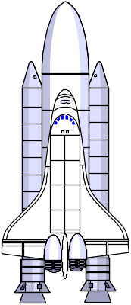
Explorers, Farmers and Tourists
Tourists: Browse information harvested by farmers
Farmers: Harvest information
from known access paths
Explorers: Seek out the unknown and previously unsuspected rewards hiding in the detailed data

Slide 14
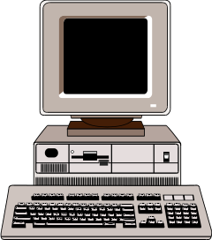
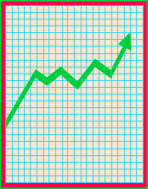
Data Warehouse Architecture
Relational
Databases
Extraction
Cleansing
Optimized Loader
ERP
Systems
Data Warehouse
Engine
Analyze
Query
Purchased
Data
Legacy
Data
Metadata Repository

Slide 15
Data Warehouse for Decision Support & OLAP
Putting Information technology to help the knowledge worker make faster and better decisions
  Which of my customers are most likely to go to the competition?
  What product promotions have the biggest impact on revenue?
  How did the share price of software companies correlate with profits over last 10 years?

Slide 16
Decision Support
Used to manage and control business
Data is historical or point-in-time
Optimized for inquiry rather than update
Use of the system is loosely defined and can be ad-hoc
Used by managers and end-users to understand the business and make judgements

Slide 17


Data Mining works with Warehouse Data
Data Warehousing provides the Enterprise with a memory
Data Mining provides the Enterprise with intelligence

Slide 18
We want to know ...
Given a database of 100,000 names, which persons are the least likely to default on their credit cards?
Which types of transactions are likely to be fraudulent given the demographics and transactional history of a particular customer?
If I raise the price of my product by Rs. 2, what is the effect on my ROI?
If I offer only 2,500 airline miles as an incentive to purchase rather than 5,000, how many lost responses will result?
If I emphasize ease-of-use of the product as opposed to its technical capabilities, what will be the net effect on my revenues?
Which of my customers are likely to be the most loyal?
Data Mining helps extract such information

Slide 19
Application Areas
Industry
Application
Finance
Credit Card Analysis
Insurance
Claims, Fraud Analysis
Telecommunication
Call record analysis
Transport
Logistics management
Consumer goods
promotion analysis
Data Service providers
Value added data
Utilities
Power usage analysis

Slide 20
Data Mining in Use
The US Government uses Data Mining to track fraud
A Supermarket becomes an information broker
Basketball teams use it to track game strategy
Cross Selling
Warranty Claims Routing
Holding on to Good Customers
Weeding out Bad Customers

Slide 21
What makes data mining possible?
Advances in the following areas are making data mining deployable:
  data warehousing
  better and more data (i.e., operational, behavioral, and demographic)
  the emergence of easily deployed data mining tools and
  the advent of new data mining techniques.
      -- Gartner Group

Slide 22
Why Separate Data Warehouse?
Performance
  Op dbs designed & tuned for known txs & workloads.
  Complex OLAP queries would degrade perf. for op txs.
  Special data organization, access & implementation methods needed for multidimensional views & queries.
Function
  Missing data: Decision support requires historical data, which op dbs do not typically maintain.
  Data consolidation: Decision support requires consolidation (aggregation, summarization) of data from many heterogeneous sources: op dbs, external sources.
  Data quality: Different sources typically use inconsistent data representations, codes, and formats which have to be reconciled.

Slide 23

What are Operational Systems?
They are OLTP systems
Run mission critical applications
Need to work with stringent performance requirements for routine tasks
Used to run a business!

Slide 24
RDBMS used for OLTP
Database Systems have been used traditionally for OLTP
  clerical data processing tasks
  detailed, up to date data
  structured repetitive tasks
  read/update a few records
  isolation, recovery and integrity are critical

Slide 25

Operational Systems
Run the business in real time
Based on up-to-the-second data
Optimized to handle large numbers of simple read/write transactions
Optimized for fast response to predefined transactions
Used by people who deal with customers, products -- clerks, salespeople etc.
They are increasingly used by customers

Slide 26
Examples of Operational Data
Data
Industry
Usage
Technology
Volumes
Customer
All
Track
Legacy application, flat
Small-medium
File
Customer
files, main frames
Details
Account
Finance
Control
Legacy applications,
Large
Balance
account
hierarchical databases,
activities
mainframe
Point-of-
Retail
Generate
ERP, Client/Server,
Very Large
Sale data
bills, manage
relational databases
stock
Call
Telecomm-
Billing
Legacy application,
Very Large
Record
unications
hierarchical database,
mainframe
Production
Manufact-
Control
ERP,
Medium
Record
uring
Production
relational databases,
AS/400

Slide 27


So, what’s different?

Slide 28
Application-Orientation vs. Subject-Orientation
Application-Orientation
Subject-Orientation
Operational Database
Data
Warehouse
Credit
Card
Loans
Customer
Vendor
Product
Trust
Savings
Activity

Slide 29
OLTP vs. Data Warehouse
OLTP systems are tuned for known transactions and workloads while workload is not known a priori in a data warehouse
Special data organization, access methods and implementation methods are needed to support data warehouse queries (typically multidimensional queries)
  e.g., average amount spent on phone calls between 9AM-5PM in Pune during the month of December

Slide 30
OLTP vs Data Warehouse
OLTP
  Application Oriented
  Used to run business
  Detailed data
  Current up to date
  Isolated Data
  Repetitive access
  Clerical User
Warehouse (DSS)
  Subject Oriented
  Used to analyze business
  Summarized and refined
  Snapshot data
  Integrated Data
  Ad-hoc access
  Knowledge User (Manager)

Slide 31
OLTP vs Data Warehouse
OLTP
  Performance Sensitive
  Few Records accessed at a time (tens)
  Read/Update Access
  No data redundancy
  Database Size 100MB -100 GB
Data Warehouse
  Performance relaxed
  Large volumes accessed at a time(millions)
  Mostly Read (Batch Update)
  Redundancy present
  Database Size 100 GB - few terabytes

Slide 32
OLTP vs Data Warehouse
OLTP
  Transaction throughput is the performance metric
  Thousands of users
  Managed in entirety
Data Warehouse
  Query throughput is the performance metric
  Hundreds of users
  Managed by subsets

Slide 33


To summarize ...
OLTP Systems are
used to “run” a business
The Data Warehouse helps to “optimize” the business

Slide 34
Why Now?
Data is being produced
ERP provides clean data
The computing power is available
The computing power is affordable
The competitive pressures are strong
Commercial products are available

Slide 35
Myths surrounding OLAP Servers and Data Marts
Data marts and OLAP servers are departmental solutions supporting a handful of users
Million dollar massively parallel hardware is needed to deliver fast time for complex queries
OLAP servers require massive and unwieldy indices
Complex OLAP queries clog the network with data
Data warehouses must be at least 100 GB to be effective
        Source -- Arbor Software Home Page

Slide 36
Wal*Mart Case Study
Founded by Sam Walton
One the largest Super Market Chains in the US
Wal*Mart: 2000+ Retail Stores
SAM's Clubs 100+Wholesalers Stores
    This case study is from Felipe Carino’s (NCR Teradata) presentation made at Stanford Database Seminar

Slide 37
Old Retail Paradigm
Wal*Mart
  Inventory Management
  Merchandise Accounts Payable
  Purchasing
  Supplier Promotions: National, Region, Store Level
Suppliers
  Accept Orders
  Promote Products
  Provide special Incentives
  Monitor and Track The Incentives
  Bill and Collect Receivables
  Estimate Retailer Demands

Slide 38
New (Just-In-Time) Retail Paradigm
No more deals
Shelf-Pass Through (POS Application)
  One Unit Price
    Suppliers paid once a week on ACTUAL items sold
  Wal*Mart Manager
    Daily Inventory Restock
    Suppliers (sometimes SameDay) ship to Wal*Mart
Warehouse-Pass Through
  Stock some Large Items
    Delivery may come from supplier
  Distribution Center
    Supplier’s merchandise unloaded directly onto Wal*Mart Trucks

Slide 39
Wal*Mart System
NCR 5100M 96 Nodes;
Number of Rows:
Historical Data:
New Daily Volume:
Number of Users:
Number of Queries:
24 TB Raw Disk; 700 - 1000 Pentium CPUs
> 5 Billions
65 weeks (5 Quarters)
Current Apps: 75 Million
New Apps: 100 Million +
Thousands
60,000 per week

Slide 40
Course Overview
0. Introduction
I. Data Warehousing
II. Decision Support and OLAP
III. Data Mining
IV. Looking Ahead
Demos and Labs

Slide 41
I. Data Warehouses:
Architecture, Design & Construction
DW Architecture
Loading, refreshing
Structuring/Modeling
DWs and Data Marts
Query Processing
demos, labs

Slide 42
Data Warehouse Architecture
Relational
Databases
Extraction
Cleansing
Optimized Loader
ERP
Systems
Data Warehouse
Engine
Analyze
Query
Purchased
Data
Legacy
Data
Metadata Repository

Slide 43
Components of the Warehouse
Data Extraction and Loading
The Warehouse
Analyze and Query -- OLAP Tools
Metadata
Data Mining tools

Slide 44

Loading the Warehouse
Cleaning the data before it is loaded

Slide 45
Source Data
Operational/
Source Data
Sequential
Legacy
Relational
External
Typically host based, legacy applications
  Customized applications, COBOL, 3GL, 4GL
Point of Contact Devices
  POS, ATM, Call switches
External Sources
  Nielsen’s, Acxiom, CMIE, Vendors, Partners

Slide 46
Data Quality - The Reality
Tempting to think creating a data warehouse is simply extracting operational data and entering into a data warehouse
Nothing could be farther from the truth
Warehouse data comes from disparate questionable sources

Slide 47
Data Quality - The Reality
Legacy systems no longer documented
Outside sources with questionable quality procedures
Production systems with no built in integrity checks and no integration
  Operational systems are usually designed to solve a specific business problem and are rarely developed to a a corporate plan
    “And get it done quickly, we do not have time to worry about corporate standards...”

Slide 48




Data Integration Across Sources
Savings
Loans
Trust
Credit card
Same data
different name
Different data
Same name
Data found here
nowhere else
Different keys
same data

Slide 49
Data Transformation Example
Data Warehouse
appl A - m,f
appl B - 1,0
appl C - x,y
appl D - male, female
encoding
appl A - pipeline - cm
appl B - pipeline - in
appl C - pipeline - feet
appl D - pipeline - yds
unit
appl A - balance
appl B - bal
appl C - currbal
appl D - balcurr
field

Slide 50
Data Integrity Problems
Same person, different spellings
  Agarwal, Agrawal, Aggarwal etc...
Multiple ways to denote company name
  Persistent Systems, PSPL, Persistent Pvt. LTD.
Use of different names
  mumbai, bombay
Different account numbers generated by different applications for the same customer
Required fields left blank
Invalid product codes collected at point of sale
  manual entry leads to mistakes
  “in case of a problem use 9999999”

Slide 51
Data Transformation Terms
Extracting
Conditioning
Scrubbing
Merging
Householding
Enrichment
Scoring
Loading
Validating
Delta Updating

Slide 52
Data Transformation Terms
Extracting
  Capture of data from operational source in “as is” status
  Sources for data generally in legacy mainframes in VSAM, IMS, IDMS, DB2; more data today in relational databases on Unix
Conditioning
  The conversion of data types from the source to the target data store (warehouse) -- always a relational database

Slide 53
Data Transformation Terms
Householding
  Identifying all members of a household (living at the same address)
  Ensures only one mail is sent to a household
  Can result in substantial savings: 1 lakh catalogues at Rs. 50 each costs Rs. 50 lakhs. A 2% savings would save Rs. 1 lakh.

Slide 54
Data Transformation Terms
Enrichment
  Bring data from external sources to augment/enrich operational data. Data sources include Dunn and Bradstreet, A. C. Nielsen, CMIE, IMRA etc...
Scoring
  computation of a probability of an event. e.g..., chance that a customer will defect to AT&T from MCI, chance that a customer is likely to buy a new product

Slide 55
Loads
After extracting, scrubbing, cleaning, validating etc. need to load the data into the warehouse
Issues
  huge volumes of data to be loaded
  small time window available when warehouse can be taken off line (usually nights)
  when to build index and summary tables
  allow system administrators to monitor, cancel, resume, change load rates
  Recover gracefully -- restart after failure from where you were and without loss of data integrity

Slide 56
Load Techniques
Use SQL to append or insert new data
  record at a time interface
  will lead to random disk I/O’s
Use batch load utility

Slide 57
Load Taxonomy
Incremental versus Full loads
Online versus Offline loads

Slide 58
Refresh
Propagate updates on source data to the warehouse
Issues:
  when to refresh
  how to refresh -- refresh techniques

Slide 59
When to Refresh?
periodically (e.g., every night, every week) or after significant events
on every update: not warranted unless warehouse data require current data (up to the minute stock quotes)
refresh policy set by administrator based on user needs and traffic
possibly different policies for different sources

Slide 60
Refresh Techniques
Full Extract from base tables
  read entire source table: too expensive
  maybe the only choice for legacy systems

Slide 61
How To Detect Changes
Create a snapshot log table to record ids of updated rows of source data and timestamp
Detect changes by:
  Defining after row triggers to update snapshot log when source table changes
  Using regular transaction log to detect changes to source data

Slide 62
Data Extraction and Cleansing
Extract data from existing operational and legacy data
Issues:
  Sources of data for the warehouse
  Data quality at the sources
  Merging different data sources
  Data Transformation
  How to propagate updates (on the sources) to the warehouse
  Terabytes of data to be loaded

Slide 63

Scrubbing Data
Sophisticated transformation tools.
Used for cleaning the quality of data
Clean data is vital for the success of the warehouse
Example
  Seshadri, Sheshadri, Sesadri, Seshadri S., Srinivasan Seshadri, etc. are the same person

Slide 64
Scrubbing Tools
Apertus -- Enterprise/Integrator
Vality -- IPE
Postal Soft

Slide 65

Structuring/Modeling Issues

Slide 66
Data -- Heart of the Data Warehouse
Heart of the data warehouse is the data itself!
Single version of the truth
Corporate memory
Data is organized in a way that represents business -- subject orientation

Slide 67
Data Warehouse Structure
Subject Orientation -- customer, product, policy, account etc... A subject may be implemented as a set of related tables. E.g., customer may be five tables

Slide 68
Data Warehouse Structure
  base customer (1985-87)
    custid, from date, to date, name, phone, dob
  base customer (1988-90)
    custid, from date, to date, name, credit rating, employer
  customer activity (1986-89) -- monthly summary
  customer activity detail (1987-89)
    custid, activity date, amount, clerk id, order no
  customer activity detail (1990-91)
    custid, activity date, amount, line item no, order no
Time is
part of
key of
each table

Slide 69
Data Granularity in Warehouse
Summarized data stored
  reduce storage costs
  reduce cpu usage
  increases performance since smaller number of records to be processed
  design around traditional high level reporting needs
  tradeoff with volume of data to be stored and detailed usage of data

Slide 70
Granularity in Warehouse
Can not answer some questions with summarized data
  Did Anand call Seshadri last month? Not possible to answer if total duration of calls by Anand over a month is only maintained and individual call details are not.
Detailed data too voluminous

Slide 71
Granularity in Warehouse
Tradeoff is to have dual level of granularity
  Store summary data on disks
    95% of DSS processing done against this data
  Store detail on tapes
    5% of DSS processing against this data

Slide 72
Vertical Partitioning
Acct.
No
Name
Balance
Date Opened
Interest
Rate
Address
Frequently
accessed
Rarely
accessed
Acct.
No
Balance
Acct.
No
Name
Date Opened
Interest
Rate
Address
Smaller table
and so less I/O

Slide 73
Derived Data
Introduction of derived (calculated data) may often help
Have seen this in the context of dual levels of granularity
Can keep auxiliary views and indexes to speed up query processing

Slide 74
Schema Design
Database organization
  must look like business
  must be recognizable by business user
  approachable by business user
  Must be simple
Schema Types
  Star Schema
  Fact Constellation Schema
  Snowflake schema

Slide 75
Dimension Tables
Dimension tables
  Define business in terms already familiar to users
  Wide rows with lots of descriptive text
  Small tables (about a million rows)
  Joined to fact table by a foreign key
  heavily indexed
  typical dimensions
    time periods, geographic region (markets, cities), products, customers, salesperson, etc.

Slide 76
Fact Table
Central table
  mostly raw numeric items
  narrow rows, a few columns at most
  large number of rows (millions to a billion)
  Access via dimensions

Slide 77
Star Schema
A single fact table and for each dimension one dimension table
Does not capture hierarchies directly
T
i
m
e
p
r
o
d
date, custno, prodno, cityname, ...
f
a
c
t
c
u
s
t
c
i
t
y

Slide 78
Snowflake schema
Represent dimensional hierarchy directly by normalizing tables.
Easy to maintain and saves storage
T
i
m
e
p
r
o
d
date, custno, prodno, cityname, ...
f
a
c
t
c
u
s
t
c
i
t
y
r
e
g
i
o
n

Slide 79
Fact Constellation
Fact Constellation
  Multiple fact tables that share many dimension tables
  Booking and Checkout may share many dimension tables in the hotel industry
Promotion
Hotels
Booking
Checkout
Travel Agents
Room Type
Customer

Slide 80
De-normalization
Normalization in a data warehouse may lead to lots of small tables
Can lead to excessive I/O’s since many tables have to be accessed
De-normalization is the answer especially since updates are rare

Slide 81
Creating Arrays
Many times each occurrence of a sequence of data is in a different physical location
Beneficial to collect all occurrences together and store as an array in a single row
Makes sense only if there are a stable number of occurrences which are accessed together
In a data warehouse, such situations arise naturally due to time based orientation
  can create an array by month

Slide 82
Selective Redundancy
Description of an item can be stored redundantly with order table -- most often item description is also accessed with order table
Updates have to be careful

Slide 83
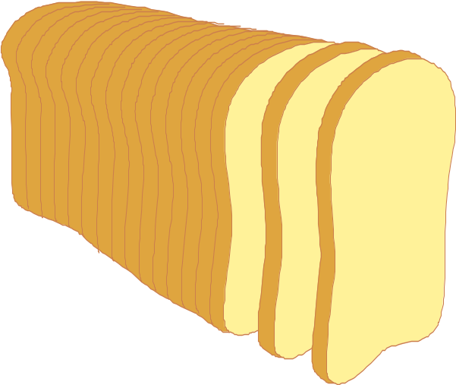
Partitioning
Breaking data into several physical units that can be handled separately
Not a question of whether to do it in data warehouses but how to do it
Granularity and partitioning are key to effective implementation of a warehouse

Slide 84
Why Partition?
Flexibility in managing data
Smaller physical units allow
  easy restructuring
  free indexing
  sequential scans if needed
  easy reorganization
  easy recovery
  easy monitoring

Slide 85
Criterion for Partitioning
Typically partitioned by
  date
  line of business
  geography
  organizational unit
  any combination of above

Slide 86
Where to Partition?
Application level or DBMS level
Makes sense to partition at application level
  Allows different definition for each year
    Important since warehouse spans many years and as business evolves definition changes
  Allows data to be moved between processing complexes easily

Slide 87
Data Warehouse vs. Data Marts
What comes first

Slide 88
From the Data Warehouse to Data Marts
Information
Individually
Structured
Less
History
Normalized
Detailed
Departmentally
Structured
Data Warehouse
Organizationally
Structured
More
Data

Slide 89
Data Warehouse and Data Marts
OLAP
Data Mart
Lightly summarized
Departmentally structured
Organizationally structured
Atomic
Detailed Data Warehouse Data

Slide 90
Characteristics of the Departmental Data Mart
OLAP
Small
Flexible
Customized by Department
Source is departmentally structured data warehouse

Slide 91
Techniques for Creating Departmental Data Mart
OLAP
Subset
Summarized
Superset
Indexed
Arrayed
Sales
Finance
Mktg.

Slide 92
Data Mart Centric
Data Sources
Data Marts
Data Warehouse

Slide 93
Problems with Data Mart Centric Solution
If you end up creating multiple warehouses, integrating them is a problem

Slide 94
True Warehouse
Data Sources
Data Warehouse
Data Marts

Slide 95


Query Processing
Indexing
Pre computed views/aggregates
SQL extensions

Slide 96
Indexing Techniques
Exploiting indexes to reduce scanning of data is of crucial importance
Bitmap Indexes
Join Indexes
Other Issues
  Text indexing
  Parallelizing and sequencing of index builds and incremental updates

Slide 97
Indexing Techniques
Bitmap index:
  A collection of bitmaps -- one for each distinct value of the column
  Each bitmap has N bits where N is the number of rows in the table
  A bit corresponding to a value v for a row r is set if and only if r has the value for the indexed attribute

Slide 98
BitMap Indexes
An alternative representation of RID-list
Specially advantageous for low-cardinality domains
Represent each row of a table by a bit and the table as a bit vector
There is a distinct bit vector Bv for each value v for the domain
Example: the attribute sex has values M and F. A table of 100 million people needs 2 lists of 100 million bits

Slide 99
Bitmap Index
gender
vote
result
gender (f)
vote (y)
M
Y
0
1
0
F
Y
1
1
1
F
N
1
0
0
M
N
0
0
0
F
Y
1
1
1
F
N
1
0
0
Customer
Query : select * from customer where
gender = ‘F’ and vote = ‘Y’

Slide 100
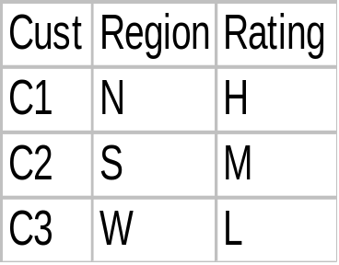
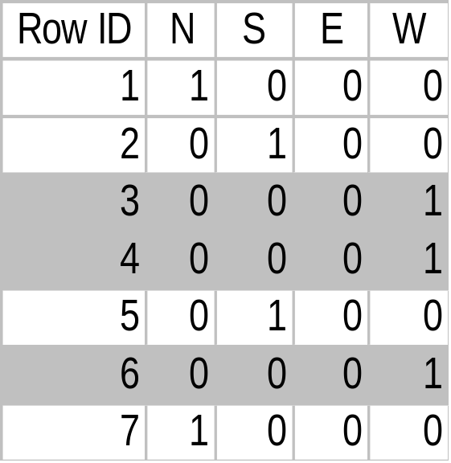
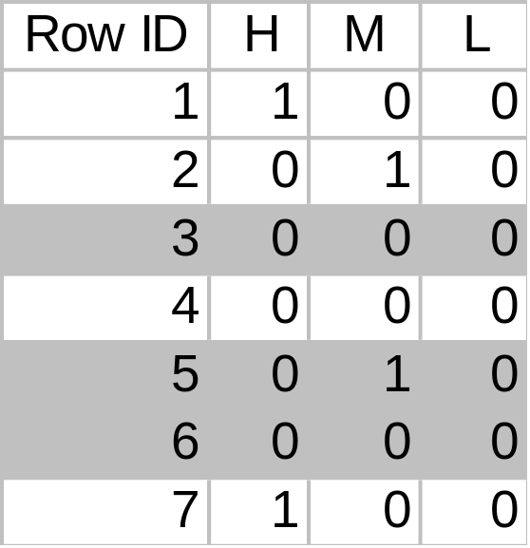
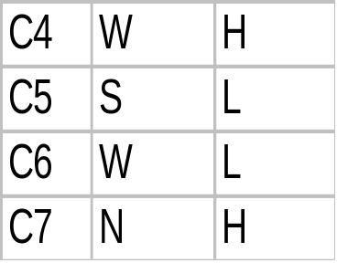
Bit Map Index
Base Table
Region Index
Rating Index
Customers where
Region = W
And
Rating = M

Slide 101
BitMap Indexes
Comparison, join and aggregation operations are reduced to bit arithmetic with dramatic improvement in processing time
Significant reduction in space and I/O (30:1)
Adapted for higher cardinality domains as well.
Compression (e.g., run-length encoding) exploited
Products that support bitmaps: Model 204, TargetIndex (Redbrick), IQ (Sybase), Oracle 7.3

Slide 102
Join Indexes
Pre-computed joins
A join index between a fact table and a dimension table correlates a dimension tuple with the fact tuples that have the same value on the common dimensional attribute
  e.g., a join index on city dimension of calls fact table
  correlates for each city the calls (in the calls table) from that city

Slide 103
Join Indexes
Join indexes can also span multiple dimension tables
  e.g., a join index on city and time dimension of calls fact table

Slide 104
Star Join Processing
Use join indexes to join dimension and fact table
Calls
C+T
Time
C+T+L
Loca-
tion
C+T+L
+P
Plan

Slide 105
Optimized Star Join Processing
Time
Apply Selections
Loca-
tion
Calls
Virtual Cross Product
of T, L and P
Plan

Slide 106
Bitmapped Join Processing
Bitmaps
Time
1
0
1
Calls
Loca-
tion
Calls
0
0
1
AND
Plan
Calls
1
1
0

Slide 107
Intelligent Scan
Piggyback multiple scans of a relation (Redbrick)
  piggybacking also done if second scan starts a little while after the first scan

Slide 108
Parallel Query Processing
Three forms of parallelism
  Independent
  Pipelined
  Partitioned and “partition and replicate”
Deterrents to parallelism
  startup
  communication

Slide 109
Parallel Query Processing
Partitioned Data
  Parallel scans
  Yields I/O parallelism
Parallel algorithms for relational operators
  Joins, Aggregates, Sort
Parallel Utilities
  Load, Archive, Update, Parse, Checkpoint, Recovery
Parallel Query Optimization

Slide 110
Pre-computed Aggregates
Keep aggregated data for efficiency (pre-computed queries)
Questions
  Which aggregates to compute?
  How to update aggregates?
  How to use pre-computed aggregates in queries?

Slide 111
Pre-computed Aggregates
Aggregated table can be maintained by the
  warehouse server
  middle tier
  client applications
Pre-computed aggregates -- special case of materialized views -- same questions and issues remain

Slide 112
SQL Extensions
Extended family of aggregate functions
  rank (top 10 customers)
  percentile (top 30% of customers)
  median, mode
  Object Relational Systems allow addition of new aggregate functions

Slide 113
SQL Extensions
Reporting features
  running total, cumulative totals
Cube operator
  group by on all subsets of a set of attributes (month,city)
  redundant scan and sorting of data can be avoided

Slide 114
Red Brick has Extended set of Aggregates
Select month, dollars, cume(dollars) as run_dollars, weight, cume(weight) as run_weights
from sales, market, product, period t
where year = 1993
and product like ‘Columbian%’
and city like ‘San Fr%’
order by t.perkey

Slide 115
RISQL (Red Brick Systems) Extensions
Aggregates
  CUME
  MOVINGAVG
  MOVINGSUM
  RANK
  TERTILE
  RATIOTOREPORT
Calculating Row Subtotals
  BREAK BY
Sophisticated Date Time Support
  DATEDIFF
Using SubQueries in calculations

Slide 116
Using SubQueries in Calculations
select product, dollars as jun97_sales,
(select sum(s1.dollars)
from market mi, product pi, period, ti, sales si
where pi.product = product.product
and ti.year = period.year
and mi.city = market.city) as total97_sales,
100 * dollars/
(select sum(s1.dollars)
from market mi, product pi, period, ti, sales si
where pi.product = product.product
and ti.year = period.year
and mi.city = market.city) as percent_of_yr
from market, product, period, sales
where year = 1997
and month = ‘June’ and city like ‘Ahmed%’
order by product;

Slide 117
Course Overview
The course: what and how
0. Introduction
I. Data Warehousing
II. Decision Support and OLAP
III. Data Mining
IV. Looking Ahead
Demos and Labs

Slide 118

II. On-Line Analytical Processing (OLAP)
Making Decision Support Possible

Slide 119

Limitations of SQL
“A Freshman in Business needs a Ph.D. in SQL”
-- Ralph Kimball

Slide 120
Typical OLAP Queries
Write a multi-table join to compare sales for each product line YTD this year vs. last year.
Repeat the above process to find the top 5 product contributors to margin.
Repeat the above process to find the sales of a product line to new vs. existing customers.
Repeat the above process to find the customers that have had negative sales growth.

Slide 121
What Is OLAP?
Online Analytical Processing - coined by
EF Codd in 1994 paper contracted by
Arbor Software*
Generally synonymous with earlier terms such as Decisions Support, Business Intelligence, Executive Information System
OLAP = Multidimensional Database
MOLAP: Multidimensional OLAP (Arbor Essbase, Oracle Express)
ROLAP: Relational OLAP (Informix MetaCube, Microstrategy DSS Agent)
* Reference: http://www.arborsoft.com/essbase/wht_ppr/coddTOC.html

Slide 122
The OLAP Market
Rapid growth in the enterprise market
  1995: $700 Million
  1997: $2.1 Billion
Significant consolidation activity among major DBMS vendors
  10/94: Sybase acquires ExpressWay
  7/95: Oracle acquires Express
  11/95: Informix acquires Metacube
  1/97: Arbor partners up with IBM
  10/96: Microsoft acquires Panorama
Result: OLAP shifted from small vertical niche to mainstream DBMS category

Slide 123
Strengths of OLAP
It is a powerful visualization paradigm
It provides fast, interactive response times
It is good for analyzing time series
It can be useful to find some clusters and outliers
Many vendors offer OLAP tools

Slide 124
OLAP Is FASMI
Fast
Analysis
Shared
Multidimensional
Information
Nigel Pendse, Richard Creath - The OLAP Report

Slide 125
Multi-dimensional Data
“Hey…I sold $100M worth of goods”
Dimensions: Product, Region, Time
Hierarchical summarization paths
Product Region Time
Industry Country Year
Category Region Quarter
Product City Month Week
Office Day
Region
W
S
N
Juice
Product
Cola
Milk
Cream
Toothpaste
Soap
1
2
3
4
5
6
7
Month

Slide 126
Data Cube Lattice
Cube lattice
  ABC
  AB AC BC
  A B C
  none
Can materialize some groupbys, compute others on demand
Question: which groupbys to materialze?
Question: what indices to create
Question: how to organize data (chunks, etc)

Slide 127
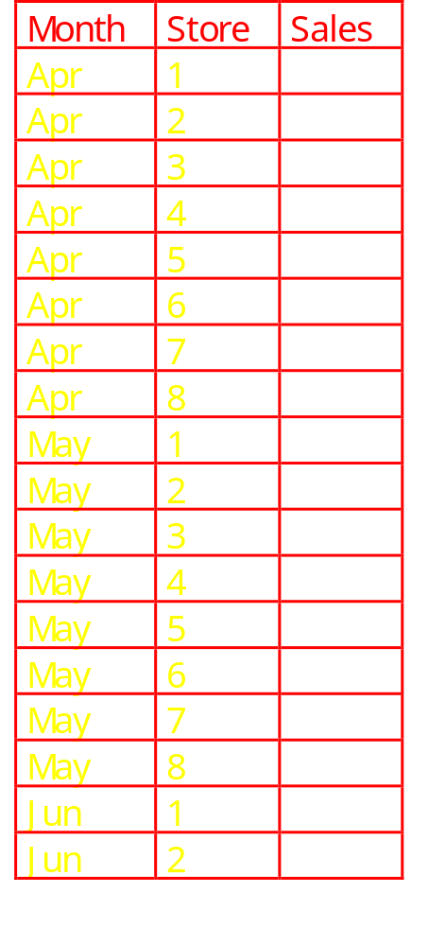
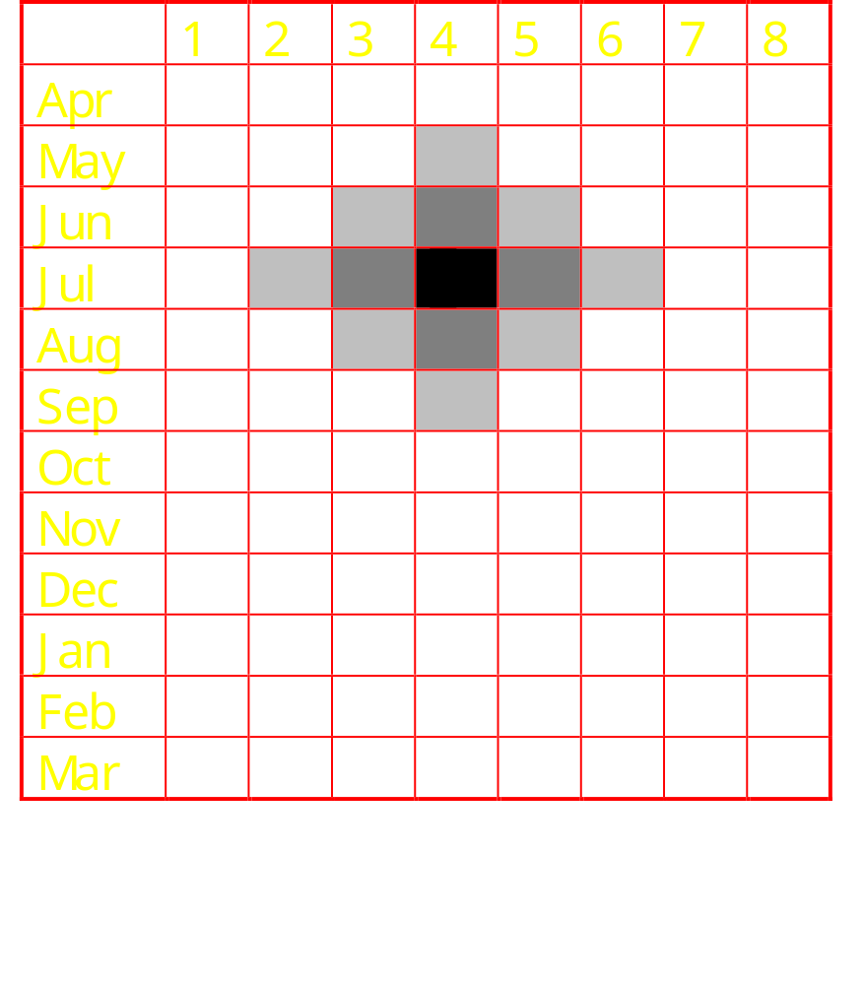
Visualizing Neighbors is simpler

Slide 128
A Visual Operation: Pivot (Rotate)
NY
LA
SF
Month
10
Juice
Cola
Milk
Cream
Region
47
30
12
Product
3/1 3/2 3/3 3/4
Date

Slide 129

“Slicing and Dicing”
The Telecomm Slice
Product
Household
Telecomm
Regions
Video
Europe
Far East
Audio
India
Retail
Direct
Special
Sales Channel

Slide 130
Roll-up and Drill Down
Higher Level of
Aggregation
Sales Channel
Region
Country
State
Location Address
Sales Representative
Drill-Down
Roll Up
Low-level
Details

Slide 131

Nature of OLAP Analysis
Aggregation -- (total sales, percent-to-total)
Comparison -- Budget vs. Expenses
Ranking -- Top 10, quartile analysis
Access to detailed and aggregate data
Complex criteria specification
Visualization

Slide 132
Organizationally Structured Data
Different Departments look at the same detailed data in different ways. Without the detailed, organizationally structured data as a foundation, there is no reconcilability of data
marketing
sales
finance
manufacturing

Slide 133

Multidimensional Spreadsheets
Analysts need spreadsheets that support
  pivot tables (cross-tabs)
  drill-down and roll-up
  slice and dice
  sort
  selections
  derived attributes
Popular in retail domain

Slide 134
OLAP - Data Cube
Idea: analysts need to group data in many different ways
  eg. Sales(region, product, prodtype, prodstyle, date, saleamount)
  saleamount is a measure attribute, rest are dimension attributes
  groupby every subset of the other attributes
    materialize (precompute and store) groupbys to give online response
  Also: hierarchies on attributes: date -> weekday,
  date -> month -> quarter -> year

Slide 135
SQL Extensions
Front-end tools require
  Extended Family of Aggregate Functions
    rank, median, mode
  Reporting Features
    running totals, cumulative totals
  Results of multiple group by
    total sales by month and total sales by product
  Data Cube

Slide 136


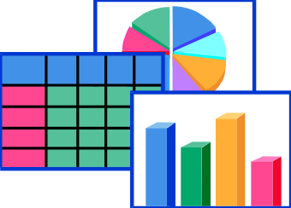
Relational OLAP: 3 Tier DSS
Data Warehouse
ROLAP Engine
Decision Support Client
Database Layer
Application Logic Layer
Presentation Layer
Store atomic data in industry standard RDBMS.
Generate SQL execution plans in the ROLAP engine to obtain OLAP functionality.
Obtain multi-dimensional reports from the DSS Client.

Slide 137

MD-OLAP: 2 Tier DSS
MDDB Engine
MDDB Engine
Decision Support Client
Database Layer
Application Logic Layer
Presentation Layer
Store atomic data in a proprietary data structure (MDDB), pre-calculate as many outcomes as possible, obtain OLAP functionality via proprietary algorithms running against this data.
Obtain multi-dimensional reports from the DSS Client.

Slide 138
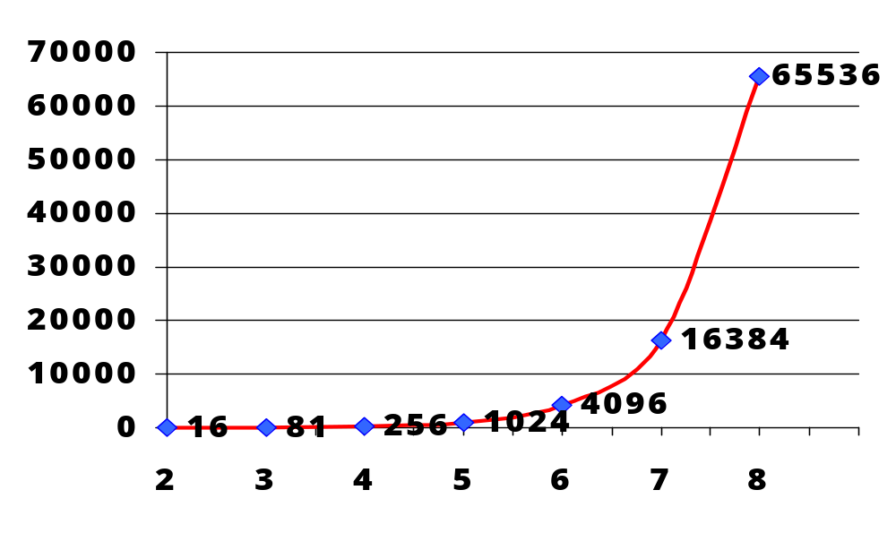
Typical OLAP Problems
Data Explosion
Data Explosion Syndrome
Number of Aggregations
(4 levels in each dimension)
Number of Dimensions
Microsoft TechEd’98

Slide 139
Metadata Repository
Administrative metadata
  source databases and their contents
  gateway descriptions
  warehouse schema, view & derived data definitions
  dimensions, hierarchies
  pre-defined queries and reports
  data mart locations and contents
  data partitions
  data extraction, cleansing, transformation rules, defaults
  data refresh and purging rules
  user profiles, user groups
  security: user authorization, access control

Slide 140
Metdata Repository .. 2
Business data
  business terms and definitions
  ownership of data
  charging policies
operational metadata
  data lineage: history of migrated data and sequence of transformations applied
  currency of data: active, archived, purged
  monitoring information: warehouse usage statistics, error reports, audit trails.

Slide 141
Recipe for a Successful Warehouse

Slide 142
For a Successful Warehouse
From Larry Greenfield, http://pwp.starnetinc.com/larryg/index.html
From day one establish that warehousing is a joint user/builder project
Establish that maintaining data quality will be an ONGOING joint user/builder responsibility
Train the users one step at a time
Consider doing a high level corporate data model in no more than three weeks

Slide 143
For a Successful Warehouse
Look closely at the data extracting, cleaning, and loading tools
Implement a user accessible automated directory to information stored in the warehouse
Determine a plan to test the integrity of the data in the warehouse
From the start get warehouse users in the habit of 'testing' complex queries

Slide 144
For a Successful Warehouse
Coordinate system roll-out with network administration personnel
When in a bind, ask others who have done the same thing for advice
Be on the lookout for small, but strategic, projects
Market and sell your data warehousing systems

Slide 145
Data Warehouse Pitfalls
You are going to spend much time extracting, cleaning, and loading data
Despite best efforts at project management, data warehousing project scope will increase
You are going to find problems with systems feeding the data warehouse
You will find the need to store data not being captured by any existing system
You will need to validate data not being validated by transaction processing systems

Slide 146
Data Warehouse Pitfalls
Some transaction processing systems feeding the warehousing system will not contain detail
Many warehouse end users will be trained and never or seldom apply their training
After end users receive query and report tools, requests for IS written reports may increase
Your warehouse users will develop conflicting business rules
Large scale data warehousing can become an exercise in data homogenizing

Slide 147
Data Warehouse Pitfalls
'Overhead' can eat up great amounts of disk space
The time it takes to load the warehouse will expand to the amount of the time in the available window... and then some
Assigning security cannot be done with a transaction processing system mindset
You are building a HIGH maintenance system
You will fail if you concentrate on resource optimization to the neglect of project, data, and customer management issues and an understanding of what adds value to the customer

Slide 148
DW and OLAP Research Issues
Data cleaning
  focus on data inconsistencies, not schema differences
  data mining techniques
Physical Design
  design of summary tables, partitions, indexes
  tradeoffs in use of different indexes
Query processing
  selecting appropriate summary tables
  dynamic optimization with feedback
  acid test for query optimization: cost estimation, use of transformations, search strategies
  partitioning query processing between OLAP server and backend server.

Slide 149
DW and OLAP Research Issues .. 2
Warehouse Management
  detecting runaway queries
  resource management
  incremental refresh techniques
  computing summary tables during load
  failure recovery during load and refresh
  process management: scheduling queries, load and refresh
  Query processing, caching
  use of workflow technology for process management

Slide 150

Products, References, Useful Links

Slide 151
Reporting Tools
Andyne Computing -- GQL
Brio -- BrioQuery
Business Objects -- Business Objects
Cognos -- Impromptu
Information Builders Inc. -- Focus for Windows
Oracle -- Discoverer2000
Platinum Technology -- SQL*Assist, ProReports
PowerSoft -- InfoMaker
SAS Institute -- SAS/Assist
Software AG -- Esperant
Sterling Software -- VISION:Data

Slide 152
OLAP and Executive Information Systems
Andyne Computing -- Pablo
Arbor Software -- Essbase
Cognos -- PowerPlay
Comshare -- Commander OLAP
Holistic Systems -- Holos
Information Advantage -- AXSYS, WebOLAP
Informix -- Metacube
Microstrategies --DSS/Agent
Microsoft -- Plato
Oracle -- Express
Pilot -- LightShip
Planning Sciences -- Gentium
Platinum Technology -- ProdeaBeacon, Forest & Trees
SAS Institute -- SAS/EIS, OLAP++
Speedware -- Media

Slide 153
Other Warehouse Related Products
Data extract, clean, transform, refresh
  CA-Ingres replicator
  Carleton Passport
  Prism Warehouse Manager
  SAS Access
  Sybase Replication Server
  Platinum Inforefiner, Infopump

Slide 154
Extraction and Transformation Tools
Carleton Corporation -- Passport
Evolutionary Technologies Inc. -- Extract
Informatica -- OpenBridge
Information Builders Inc. -- EDA Copy Manager
Platinum Technology -- InfoRefiner
Prism Solutions -- Prism Warehouse Manager
Red Brick Systems -- DecisionScape Formation

Slide 155
Scrubbing Tools
Apertus -- Enterprise/Integrator
Vality -- IPE
Postal Soft

Slide 156
Warehouse Products
Computer Associates -- CA-Ingres
Hewlett-Packard -- Allbase/SQL
Informix -- Informix, Informix XPS
Microsoft -- SQL Server
Oracle -- Oracle7, Oracle Parallel Server
Red Brick -- Red Brick Warehouse
SAS Institute -- SAS
Software AG -- ADABAS
Sybase -- SQL Server, IQ, MPP

Slide 157
Warehouse Server Products
Oracle 8
Informix
  Online Dynamic Server
  XPS --Extended Parallel Server
  Universal Server for object relational applications
Sybase
  Adaptive Server 11.5
  Sybase MPP
  Sybase IQ

Slide 158
Warehouse Server Products
Red Brick Warehouse
Tandem Nonstop
IBM
  DB2 MVS
  Universal Server
  DB2 400
Teradata

Slide 159
Other Warehouse Related Products
Connectivity to Sources
  Apertus
  Information Builders EDA/SQL
  Platimum Infohub
  SAS Connect
  IBM Data Joiner
  Oracle Open Connect
  Informix Express Gateway

Slide 160
Other Warehouse Related Products
Query/Reporting Environments
  Brio/Query
  Cognos Impromptu
  Informix Viewpoint
  CA Visual Express
  Business Objects
  Platinum Forest and Trees

Slide 161
4GL's, GUI Builders, and PC Databases
Information Builders -- Focus
Lotus -- Approach
Microsoft -- Access, Visual Basic
MITI -- SQR/Workbench
PowerSoft -- PowerBuilder
SAS Institute -- SAS/AF

Slide 162
Data Mining Products
DataMind -- neurOagent
Information Discovery -- IDIS
SAS Institute -- SAS/Neuronets

Slide 163
Data Warehouse
W.H. Inmon, Building the Data Warehouse, Second Edition, John Wiley and Sons, 1996
W.H. Inmon, J. D. Welch, Katherine L. Glassey, Managing the Data Warehouse, John Wiley and Sons, 1997
Barry Devlin, Data Warehouse from Architecture to Implementation, Addison Wesley Longman, Inc 1997

Slide 164
Data Warehouse
W.H. Inmon, John A. Zachman, Jonathan G. Geiger, Data Stores Data Warehousing and the Zachman Framework, McGraw Hill Series on Data Warehousing and Data Management, 1997
Ralph Kimball, The Data Warehouse Toolkit, John Wiley and Sons, 1996

Slide 165
OLAP and DSS
Erik Thomsen, OLAP Solutions, John Wiley and Sons 1997
Microsoft TechEd Transparencies from Microsoft TechEd 98
Essbase Product Literature
Oracle Express Product Literature
Microsoft Plato Web Site
Microstrategy Web Site

Slide 166
Data Mining
Michael J.A. Berry and Gordon Linoff, Data Mining Techniques, John Wiley and Sons 1997
Peter Adriaans and Dolf Zantinge, Data Mining, Addison Wesley Longman Ltd. 1996
KDD Conferences

Slide 167
Other Tutorials
Donovan Schneider, Data Warehousing Tutorial, Tutorial at International Conference for Management of Data (SIGMOD 1996) and International Conference on Very Large Data Bases 97
Umeshwar Dayal and Surajit Chaudhuri, Data Warehousing Tutorial at International Conference on Very Large Data Bases 1996
Anand Deshpande and S. Seshadri, Tutorial on Datawarehousing and Data Mining, CSI-97

Slide 168
Useful URLs
Ralph Kimball’s home page
  http://www.rkimball.com
Larry Greenfield’s Data Warehouse Information Center
  http://pwp.starnetinc.com/larryg/
Data Warehousing Institute
  http://www.dw-institute.com/
OLAP Council
  http://www.olapcouncil.com/

